Slide 1
Travel in time

Slide 2
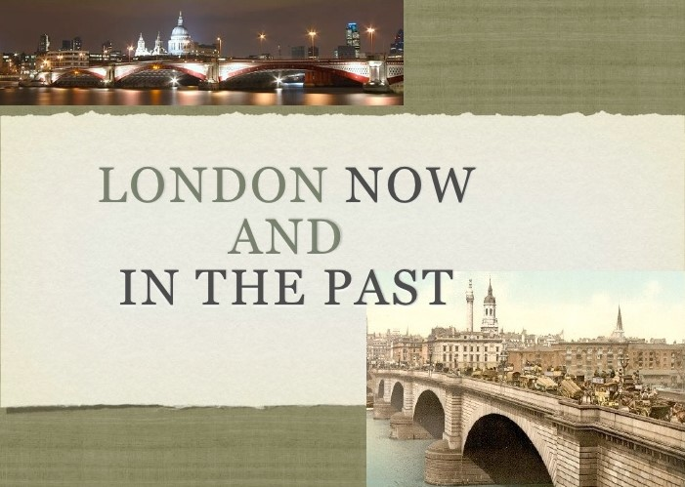

Slide 3
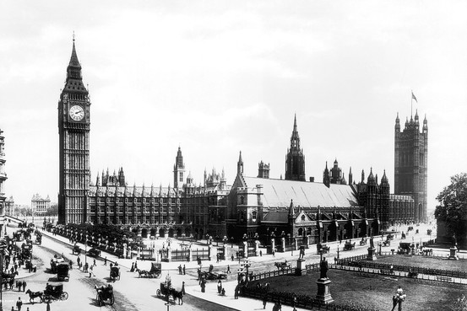
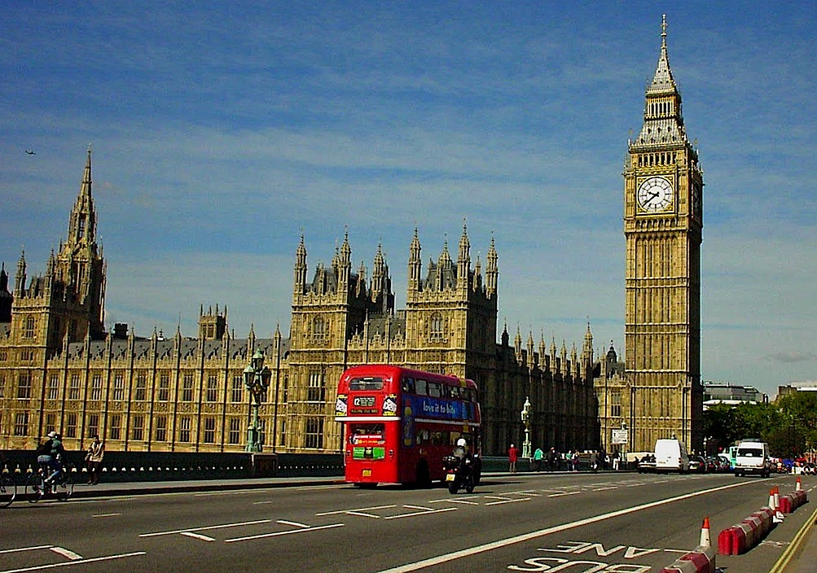
What was London like a
hundred years ago?
It was very different to London
today .
Let’s see!

Slide 4
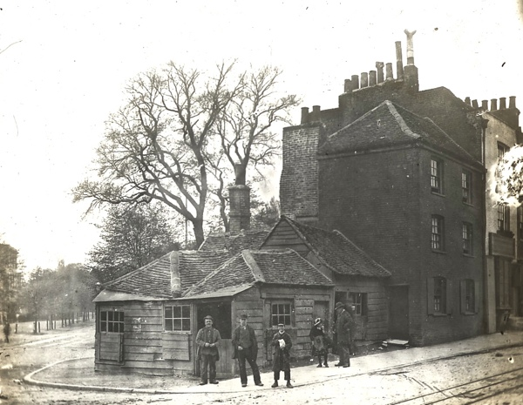
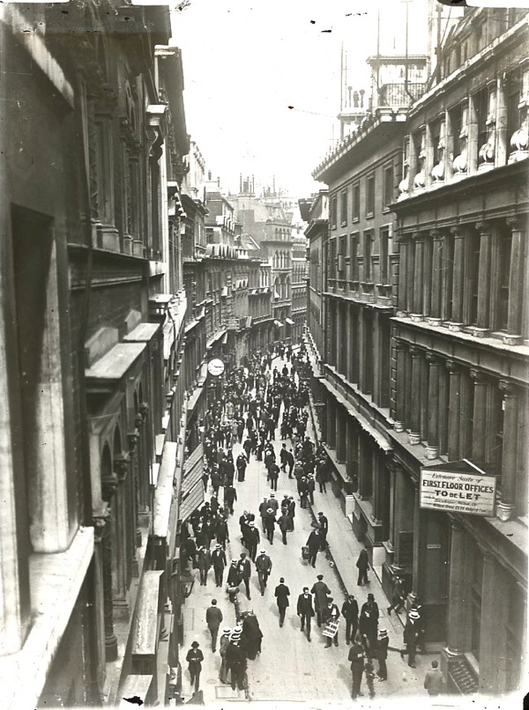

Slide 5
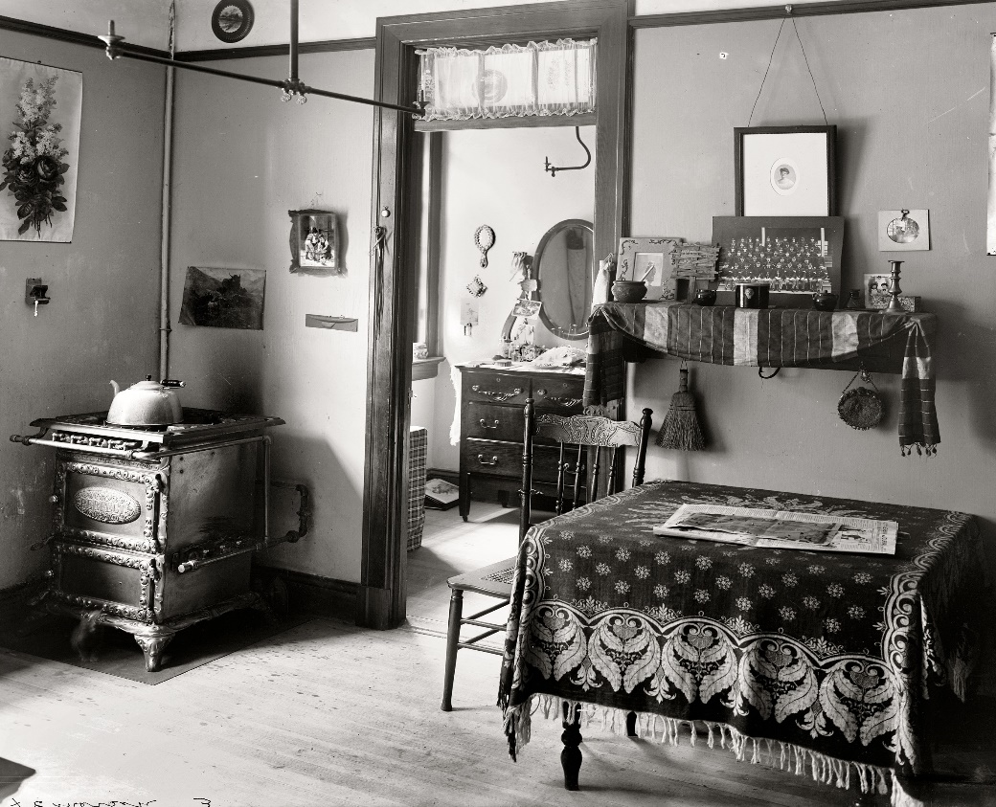
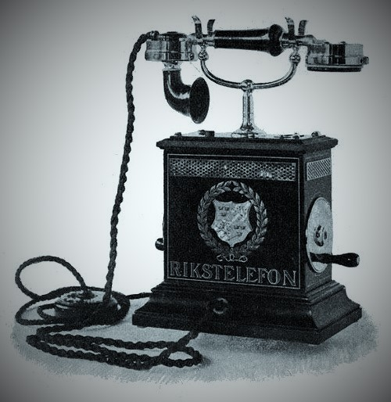

Slide 6
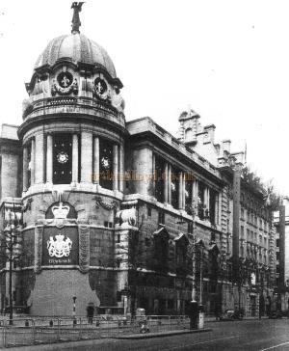
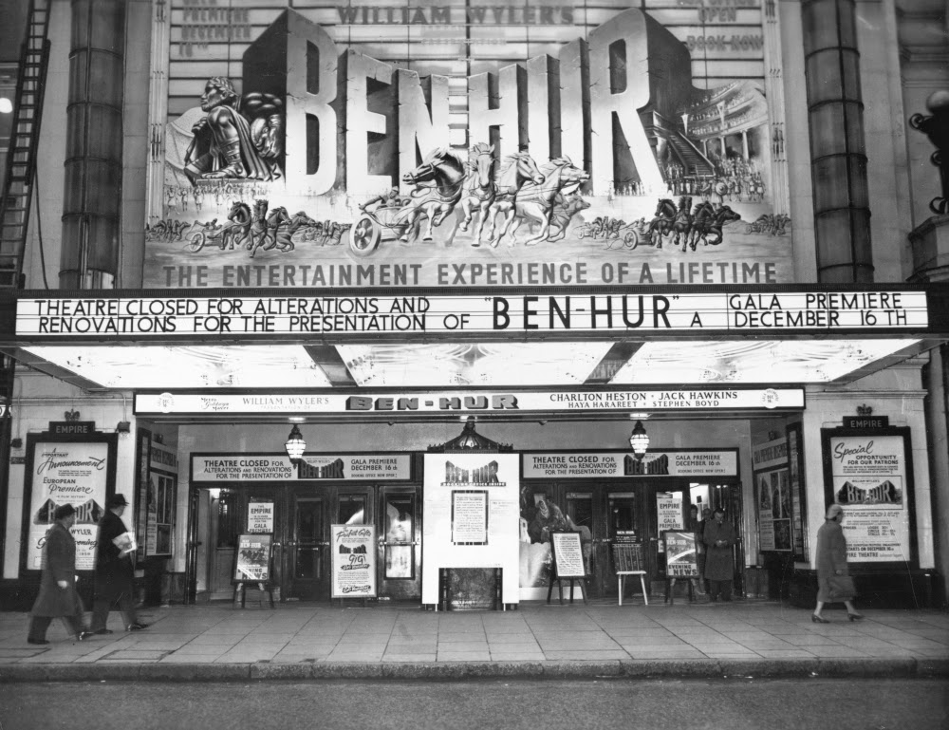

Slide 7
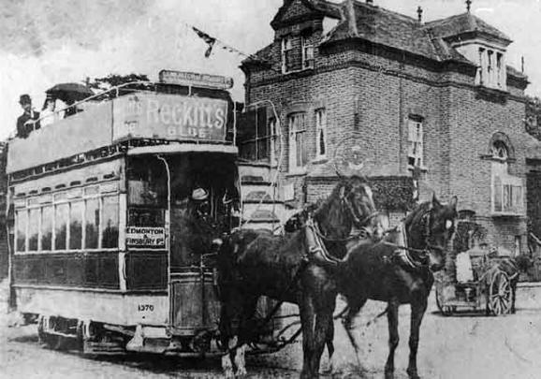
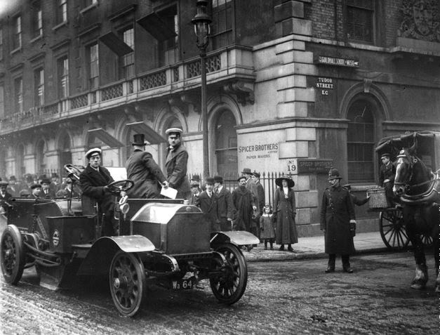

Slide 8
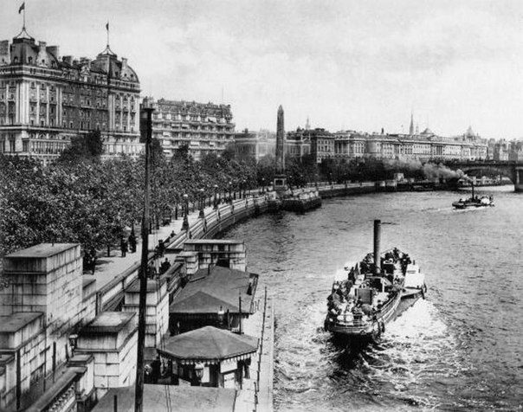
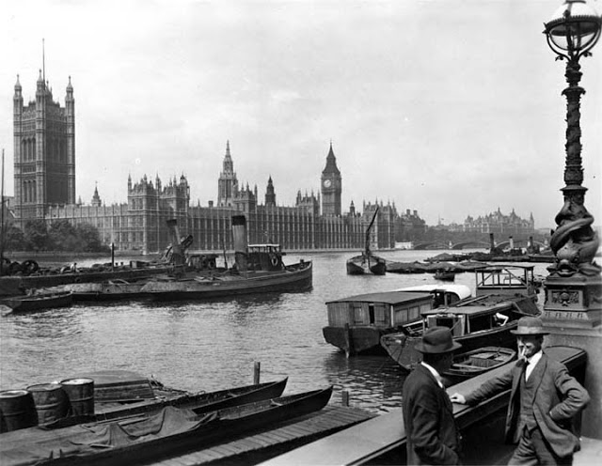

Slide 9
Answer the questions
1 London was a very small city a hundred
years ago.
2 Some people had electric lights in
their houses.
3 People had computers and TVs in
their houses.
4 Lots of people had horses and carriages.
5 There were lots of cars and buses.
6 There was a big airport.
7 People could travel by boats.

Slide 10
Complete the sentences with
There was/ There wasn’t
There were/ There weren’t
There were
1 ………………...... theatres in London .
2 …………….......... a cooker in the kitchen.
3 …………………….. any TVs in the houses.
4 …………………….. phones in some houses.
5 …………………….. an airport.
6 ……………………. a lot of cars in the streets.
There was
There weren't
There were
There wasn’t
There weren’t

Slide 11
Find some mistakes in the picture and complete
the sentences.
A hundred years ago
they had…
A hundred years ago
they didn’t have any ...

Slide 12
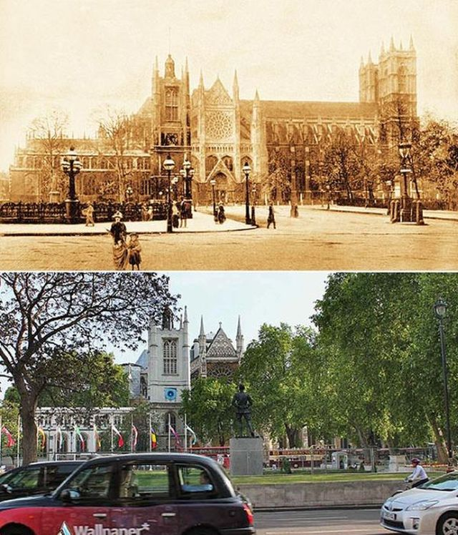

Slide 13
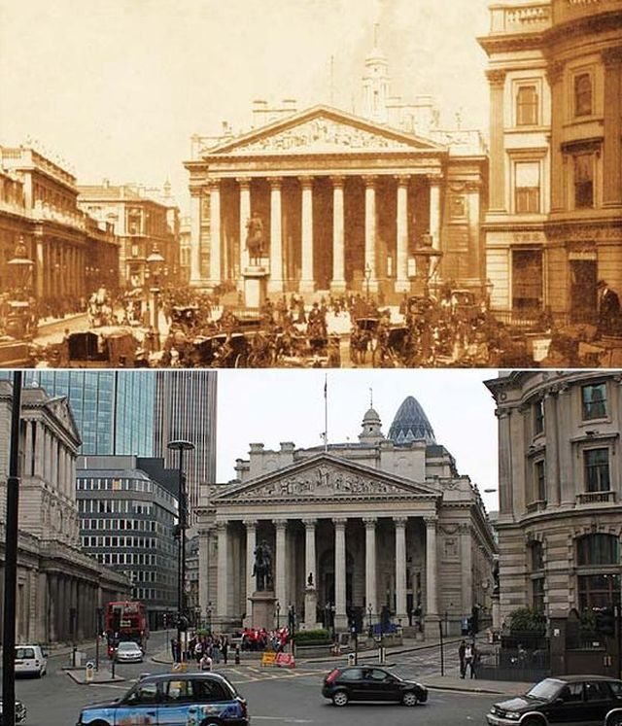

Slide 14

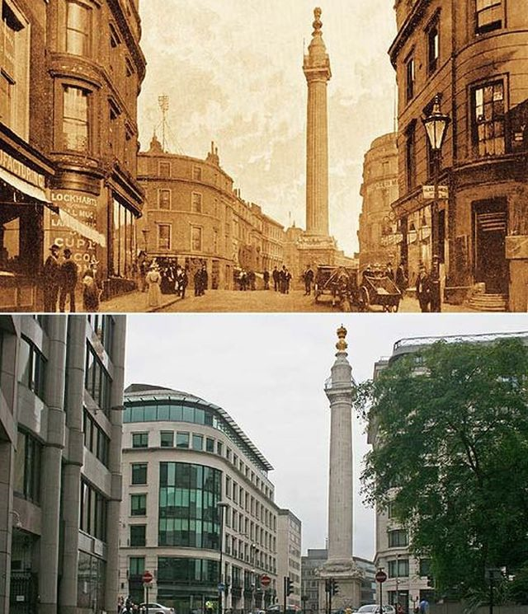

Slide 15
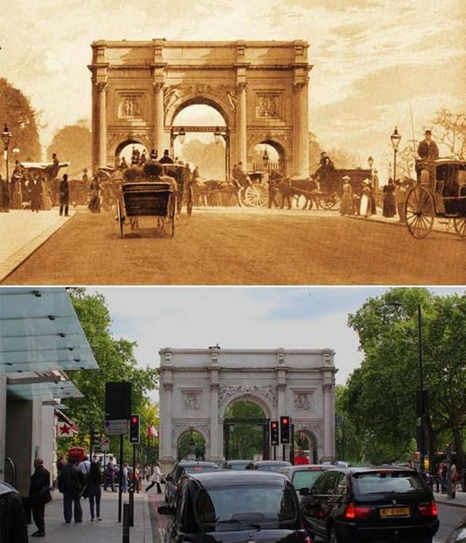

Slide 16

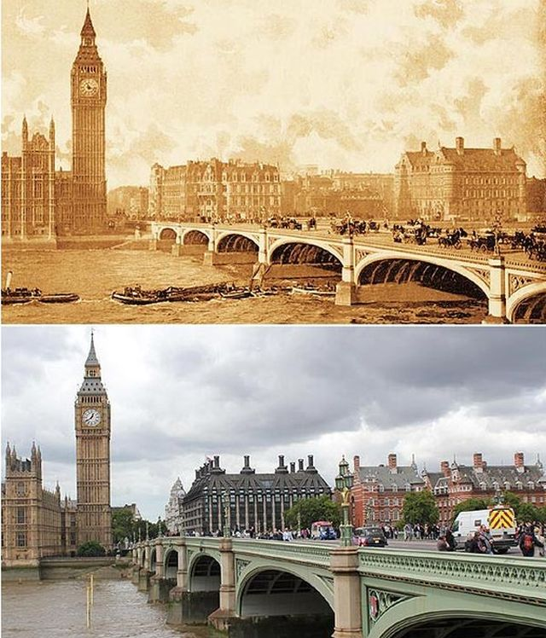

Slide 17
Top 10 attractions of London
5
Tower of London
Thames river cruise
London bridge
Double decker bus
Covent garden
Trafalgar square
St. Paul’s Cathedral
London eye
Houses of Parliament
Buckingham Palace
7
4
8
6
9
10
1
3
2

Slide 18
Top 10 attractions of London
1 London Eye
2 Buckingham Palace
3 Houses of Parliament
4 London bridge
5 Tower of London
6 Coven garden
7 Thames river cruise
8 Double decker bus
9 Trafalgar square
10 St. Paul’s Cathedral

Slide 19
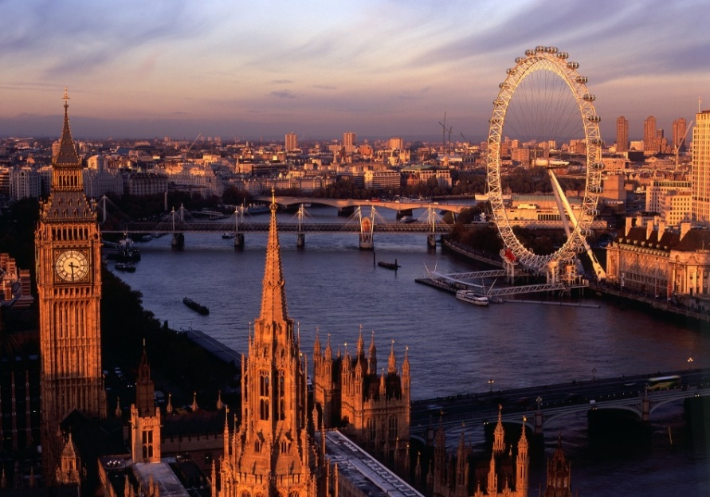
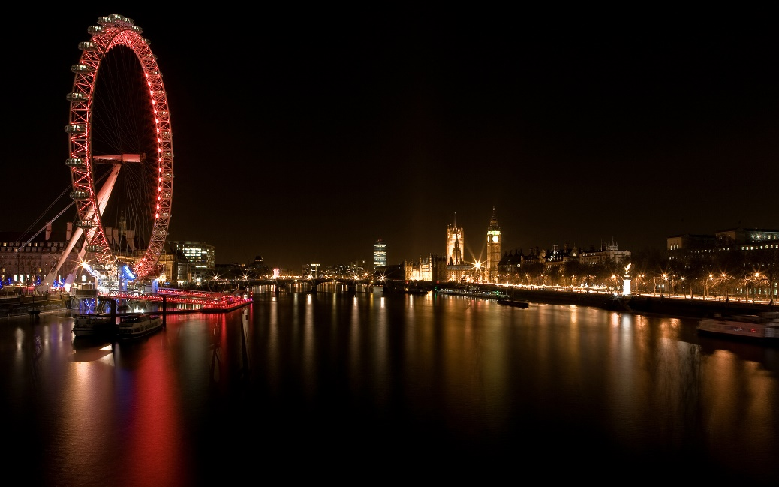
The London Eye
The London Eye is 135 meters high and it is very safe so you aren’t thirsty/ .
In the day you can see boring/
views of London.
You can learn /dangerous facts about the history of London.
scared
amazing
interesting
At night it is sunny/ . When it is / funny , you
can see lights everywhere.
exciting
dark

Slide 20
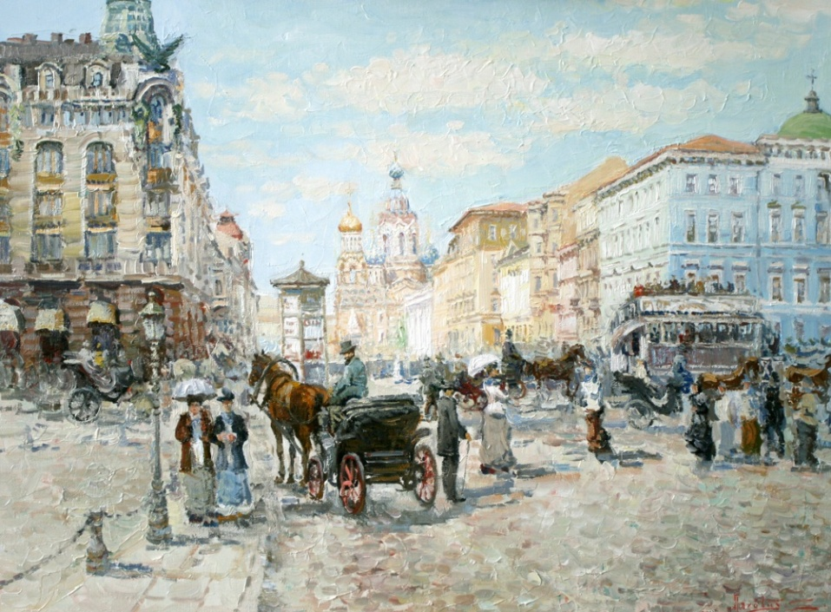
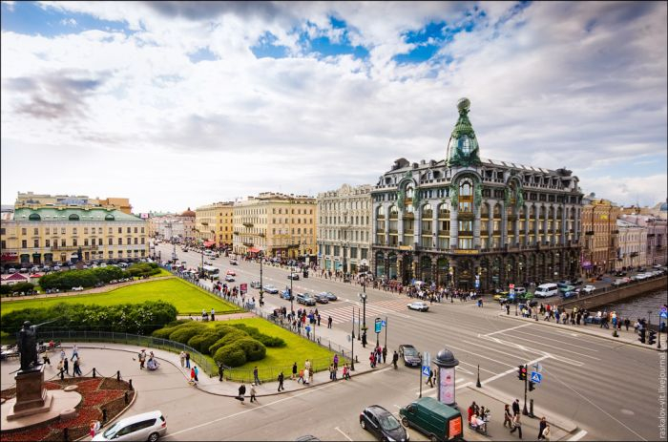
now
There is …/ There are…
There isn’t …/ There aren’t…
a hundred years ago
There was …/ There were…
There wasn’t …/ There weren’t…

Slide 21
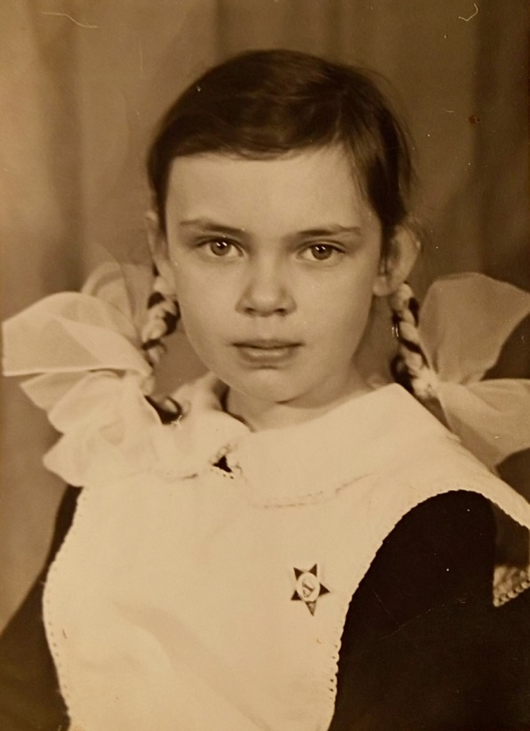
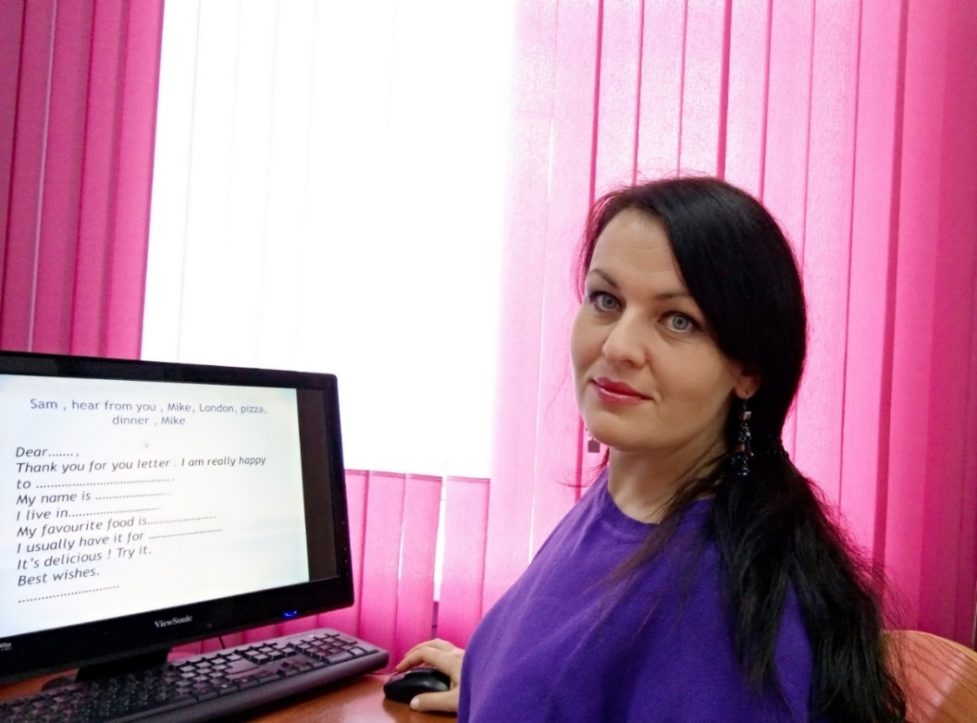

Slide 22
When I was one
I could say the word “ Mum”,
When I was two
I was talkative like a cockatoo,
When I was three
I could talk to the tree ,
When I was five
I could swim and dive,
When I was four
I could open the castle door,
When I was eight
Nessie was my best, best mate,
When I was seven
I could fly with a raven,
When I was six
I could do magic tricks,
When I was nine
I could travel in time !

Slide 23
Travel in time

