Slide 1
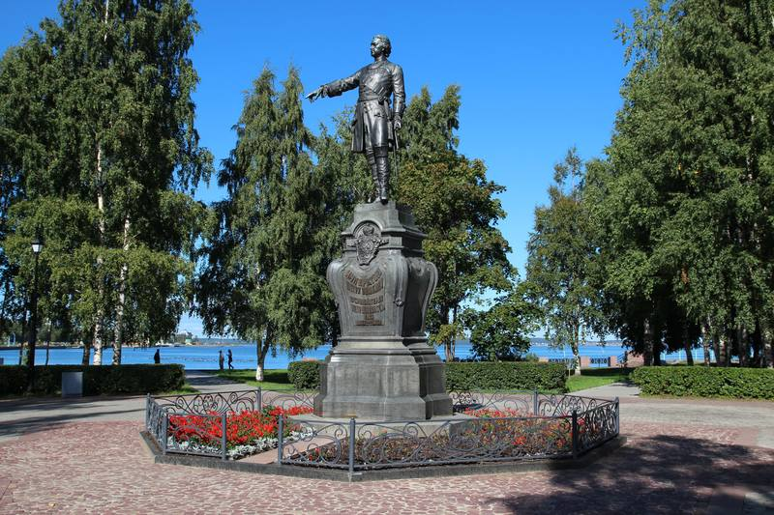
“The soul of Russia – Karelia!”

Slide 2
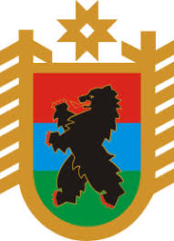
The Republic of Karelia is a territorial subject of the Russian Federation. It is situated in northern Europe, in the north-western part of Russia. Its area makes up 180 520 km². In the north-east the region is washed by the White Sea. The western border of Karelia (798 km) is the state border of the Russian Federation and Finland, the European Union.

Slide 3
The capital of the region is Petrozavodsk (275,000). The largest cities in Karelia are Kondopoga (31 000), Kostomuksha (29 000), Segezha (27 000).

Slide 4
The population of Karelia is about 630 000 people: Russians (82.2%), Karels (7.4%), Belarussians (3.8%), Ukrainians (2%), Finns (1.4%), Veps (0.5%). The official language in Karelia is Russian. At the same time, there are peoples whose written language is based on the Roman alphabet (Karels and Veps).

Slide 5
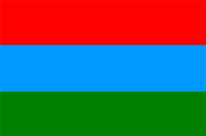
History of Karelia
People began to settle in Karelia in the 7th-6th millennium BC. The main occupations of the ancient inhabitants of this land were hunting and fishing. At the end of the 1st millennium AD, various tribes of Finno-Ugric groups lived in this region: Karels - on the Karelian Isthmus and the Northern Ladoga region, Veps - between Lakes Ladoga and Onega, Saami (Lop’) - further north.
In the 9th century, the territory of Karelia went into the sphere of influence of Kievan Rus.
In the 12th century Karelia became part of another ancient Russian state - Novgorod Republic. The town of Korela (present Priozersk in the Leningrad region) became its centre.
In 1227, Novgorod prince Yaroslav Vsevolodovich baptized Karels in the Orthodox faith. Veps also became Orthodox Christians.
At the end of the 13th century, Swedes seized part of the land in the western Karelia, where they founded the fortress of Vyborg (1293). However, their further advance was stopped by Russians and Karels.
In 1478, Karelia together with other lands of Novgorod Republic was annexed to the Russian state (the Moscow State).
In the late 16th - early 17th centuries, Swedes continued to expand eastward. According to Stolbovsky Treaty of 1617, Russia lost the Karelian Isthmus.

Slide 6
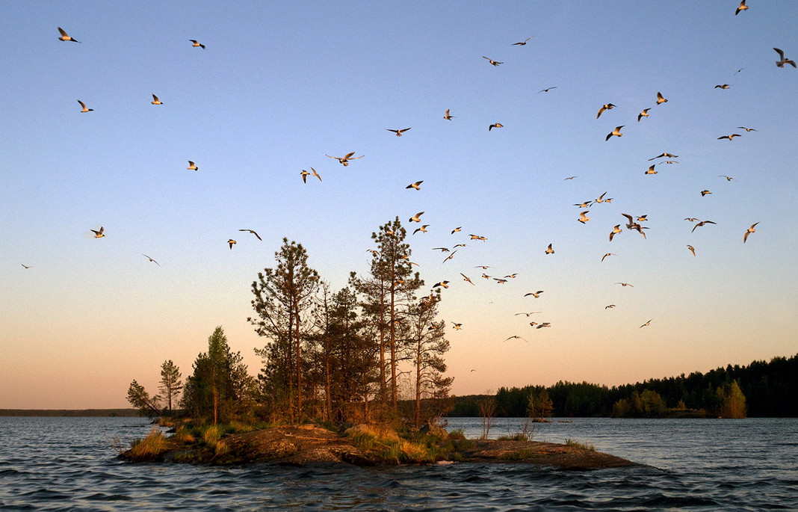
Karelia is a beautiful land of white nights, boundless forests and blue lakes.
It has about 60,000 lakes, including the two largest lakes in Europe - Ladoga and Onega. Other large lakes: Nook, Pyaozero, Segozero, Syamozero, Topozero, Vygozero, Yushkozero.
The White Sea-Baltic Canal (228 km) connects the basins of the Baltic and White seas.
There are about 27 000 rivers in the region. The largest rivers are Vodla (149 km), Kem (191 km), Onda (197 km), Unga, Chirka-Kem (221 km), Kovda, Shuya, Suna with Kivach and Vyg waterfalls.
Forests cover about 85% of the territory of Karelia. The main minerals are iron ore, titanium, vanadium, molybdenum, precious metals, diamonds, mica, building materials.
The economy of Karelia is based on metallurgy, mining, wood and paper industries.

Slide 7
Karelia is attractive for Russian and foreign tourists. It is one of the most famous Russian territories in international tourism thanks to the presence of unique architectural, cultural and historical sites on the islands (Kizhi, Valaam and Solovki). They are included in the list of UNESCO World Heritage Sites and are a national treasure of Russia.

Slide 8
Sights of Karelia

Slide 9
The unique Kizhi open-air museum on Lake Onega is the world famous monument of wooden architecture.

Slide 10
Valaam Monastery on Lake Ladoga

Slide 11
Solovki is a historical and cultural complex on the Solovetsky Islands.

Slide 12
The “Paanajarvi” National Park

Slide 13
The Ruskeala Mountain Park

Slide 14
Ruskeala waterfalls on the Tohmajoki River

Slide 15
Nature Reserve Kivach on the Suna River, founded in 1932, is one of the oldest in Russia.

Slide 16
The Vedlozersky National Park

Slide 17
The Sortavala National Park

Slide 18
“White bridges” waterfall

Slide 19
Kivakkakoski waterfall on the Olanga River

Slide 20
Kostomukshsky State Natural Reserve

Slide 21
Lake Ladoga

Slide 22
Lake Onega

Slide 23
Janisjarvi lake

Slide 24
Ur lake

Slide 25
Vyg lake

Slide 26
Petroglyphs of Lake Onega are images of the Neolithic period near Pudozh.

Slide 27
The White Sea petroglyphs are ancient pictures carved into the rocks near Belomorsk.

Slide 28
Mount Vottovaara

Slide 29
Mount Paaso

Slide 30
Girvas volcano

Slide 31
The first Russian spa resort “Marcial Waters” was founded by decree of Peter the Great in 1719.

Slide 32
Architectural ensemble of Ilyinsky churchyard

Slide 33
Murom Monastery

Slide 34
The village of Kinerma

Slide 35
The Church of the Epiphany in the village of Chelmuzhi

Slide 36
Church of the Assumption of the Blessed Virgin (1774) in Kondopoga

Slide 37
The Veps’ ethnographical Museum in the village of Sheltozero

Slide 38
The National Museum of the Republic of Karelia

Slide 39
The Maritime Мuseum

Slide 40
The Karelian Zoo

Slide 41
Karelia is a historical museum of national culture, world-famous monuments and picturesque landscape as well as charming hospitable people. This fantastic tour is a wonderful holiday for you with lots attractive places to visit and unique sights to see. You will travel to well-known towns with beautiful ancient cathedrals and magnificent houses. You will also take part in an enjoyable trip to the amazing lakes of Karelia.

Slide 42
Welcome to Karelia!

