Slide 1
Государственное бюджетное профессиональное образовательное учреждение Республики Дагестан «Дагестанский базовый медицинский колледж им. Р.П. Аскерханова.»
Презентация практического занятия на тему:
«Выдающиеся люди России»
Рассмотрено и утверждено
на заседании цикловой
методической комиссии
общеобразовательных дисциплин N1
Протокол__
___________
Председатель ЦМК_________
Э.Б.Рамазанова
Дисциплина: __ОУД 02__Иностранный язык_______________
Специальность:___Сестринское дело_______________
Подготовила: __Д.М. Керимова__________________
2026г.

Slide 2
Цель:
Ознакомить студентов с жизнью и деятельностью выдающегося российского
ученого-медика, его вкладом в развитие науки и медицины.
Расширить сферу профессиональных интересов.

Slide 3
Опрос по теме: «Прямая и косвенная речь»
Замените прямую речь косвенной: 1. I said to him, "Please open the door." 2. I said to her, "Copy out this exercise." 3. I said to him, "Please don't be angry." 4. He said to me, "Don't wait for me." 5. She said to me, "Don't be late." 6. He said to me, "Please send us the contract by return of mail." 7. I said to him, "Don't sell these goods before you receive my telegram." 8. He said to the secretary, "Bring me the letters we have received this morning." 9. He said to me, "Please state in your letter how payment is to be made." 10. I said to him, "Send me a telegram when the steamer arrives in Leningrad." 11. I said to him, "Don't forget to state in the letter that the offer is without obligation." 12. I said to the secretary, "Write to them that we cannot offer the goods for immediate shipment."
Ответы:
1. I asked him to open the door. 2. I told her to copy out this (or: that) exercise. 3. I asked him not to be angry. 4. He told me not to wait for him. 5. She told me not to be late. 6. He asked me to send them the contract by return of mail. 7. I told him not to sell these goods before he received my telegram. 8. He told the secretary to bring him the letters they had received that (or: this) morning. 9. He asked me to state in my letter how payment was to be made. 10. I told him to send me a telegram when the steamer arrived in Leningrad. 11. I told him not to forget to state in the letter that the offer was without obligation. 12. I told the secretary to write to them that we could not offer the goods for immediate shipment.

Slide 4
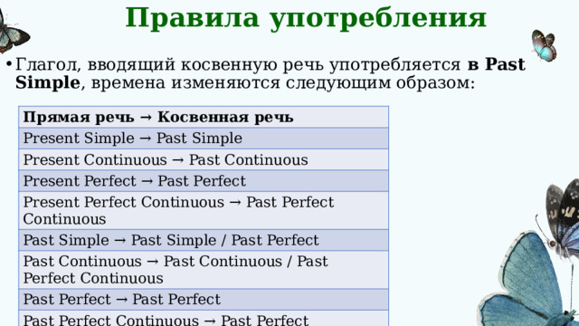

Slide 5
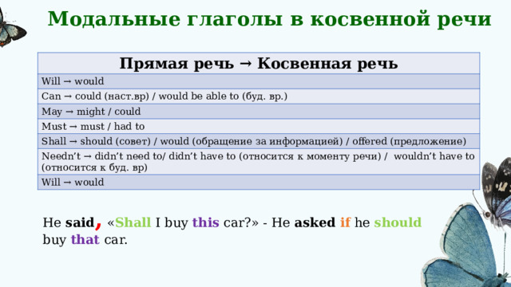

Slide 6
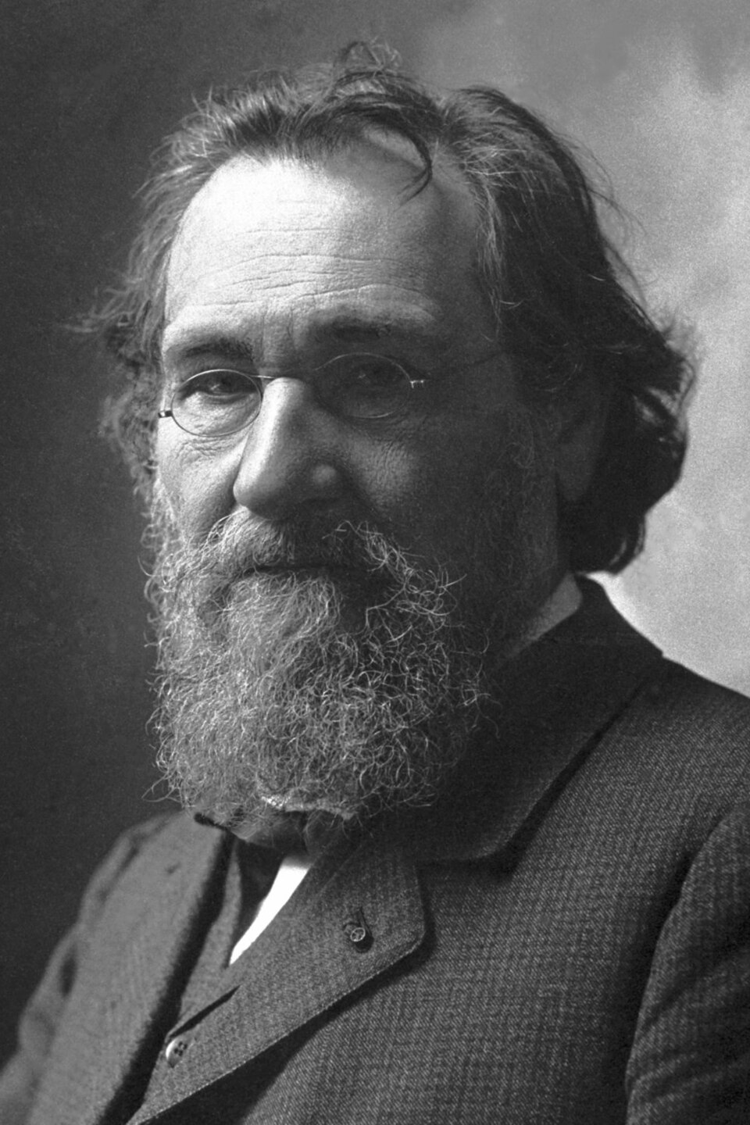
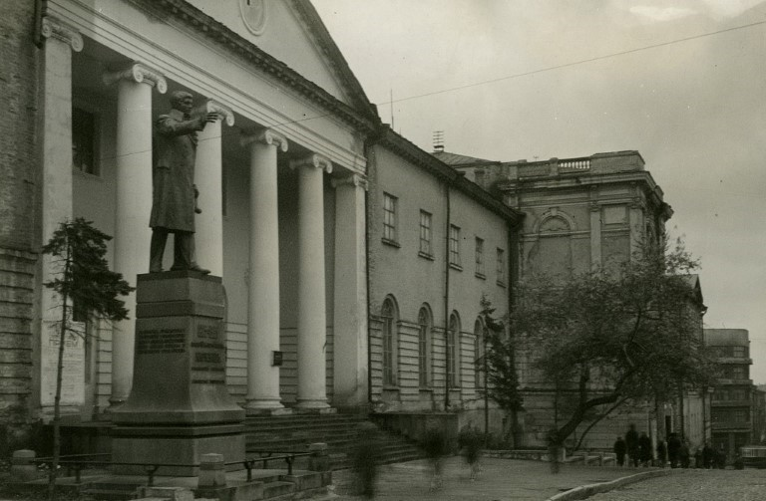
Новая тема:
I. I. Mechnikov was born in 1845 in the village if Ivanovka, not far from the city of Kharkov.
Since his early childhood I. I. Mechnikov had become interested in natural sciences. Being a pupil of the sixth form he began to attend the course of university lectures. Mechnikov graduated from Kharkov University when he was only 19 years old. While studying at the University he published several scientific articles in zoology.

Slide 7

In 1870 at the age of 25 Mechnikov became one of the leading professor of Odessa University. But twelve years later, in 1882 he left the University demonstrating his protest against the tzarist ministry of education. He began his intense work in his private laboratory. In 1887 Mechnikov went abroad and spent almost 30 years in Paris at the Pasteur Institute.
I. I. Mechnikov was the first to observe the phenomenon of phagocytosis in experiments with lower animals.

Slide 8
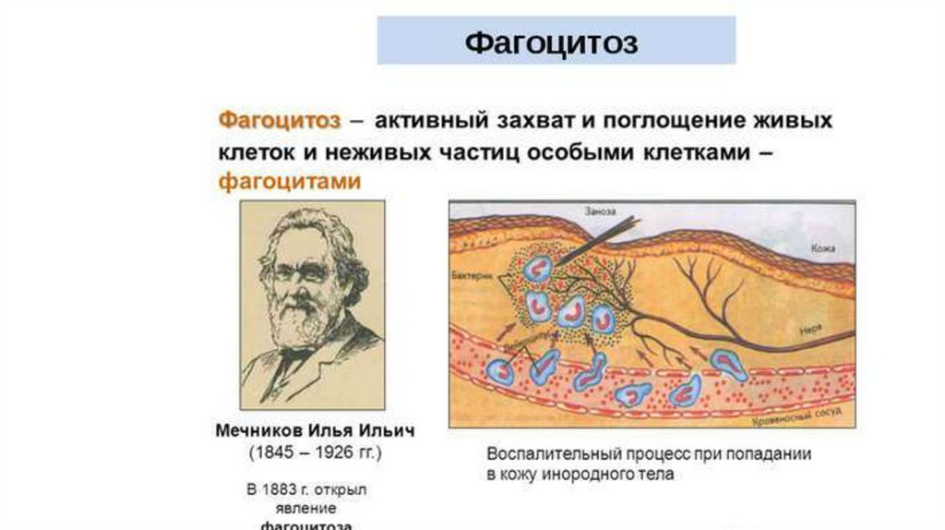
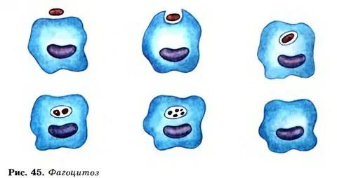
Mechnikov took great interest in this phenomenon and began his regular observations. On the basis of his observations he proved that that while blood cells of the human being had the ability to pass through the walls of the capillary vessels and to destroy the invading microbes. Mechnikov called these cells phagocytes and the phenomenon itself phagocytosis. He also determined what defence forces the human body had and why not every bacterial infection resulted in a disease.

Slide 9
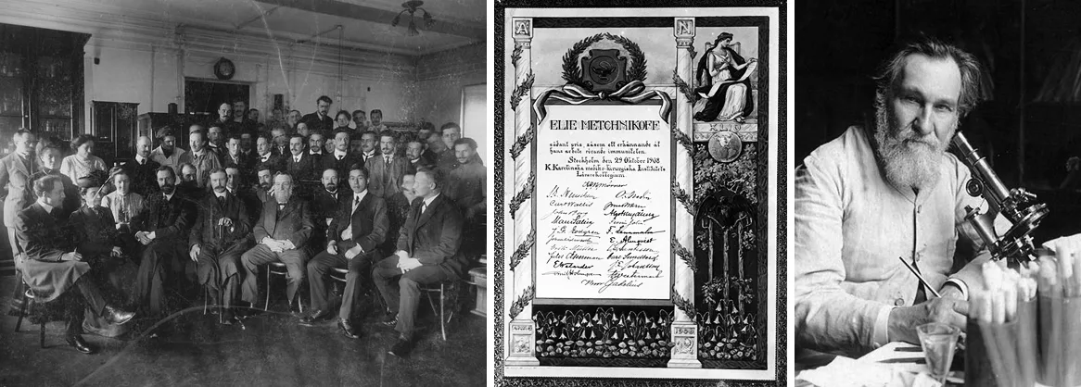
In 1908 I. I. received the Nobel Prize for his investigations on phagocytosis. Mechnikov performed considerable work on the effect of lactic acid on bacteria and devoted many years of he life to the problem of aging.
He dead in 1916 at the age of 71.

Slide 10
Notes
childhood - детство
to become interesting - заинтересоваться
natural sciences - естественные науки
to attend - посещать
to graduate from (the University) - закончить (университет)
tzarist ministry of education - царское министерство образования
to go abroad - уехать за границу
to observe – наблюдать
to take great interest in - сильно заинтересоваться чем-либо, проявлять интерес к чему - либо
to determine - определять
white blood cells - белые кровяные клетки
defence forces - защитные силы
to result in - приводить к чему-либо
considerable - значительный
to devote - посвящать
the problem of aging – проблема старения

Slide 11
Закрепление
Закончите предложения:
I. I. Mechnikov was born in…
Since his early childhood Mechnikov had became interested in…
Mechnikov graduated from the University when he was only…
In … Mechnikov became one of the leading professors od Odessa University.
Twelve years later he left the University demonstrating his protest against…
In 1887 Mechnikov went abroad and spent almost 30 years in…
I. I. Mechnikov eas the first to observe…
Mechnikov called these cells… and the phenomenon itself…
In 1908 I. I. Mechnikov received the Nobel Prize for his…
10) Mechnikov performed considerable work on the effect of … on bacteria and devoted many years of his life to the problem of…
11) He died in …

Slide 12
Домашняя работа
Подготовить пересказ текста о Мечникове.
Выучить новую лексику.

