Slide 1
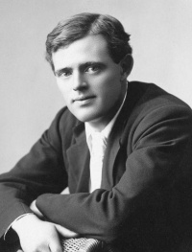
Jack London – The King of American Adventure
(dedicated to
the 150th anniversary
of Jack London)
2026

Slide 2

«Jack London was not merely a writer; he was a living legend».

Slide 3
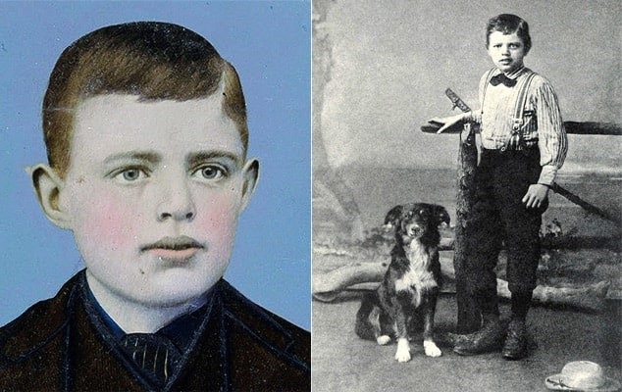
«When Destiny Knocked: The Birth Story of Jack London»
John Griffith London, better known as Jack London, was born on January 12, 1876, in San Francisco, the USA. Growing up in poverty, young Jack had to work from an early age. He held various jobs – from working in a cannery to sailing on ships and even becoming an oyster pirate. These early experiences would later serve as inspiration for many of his stories.

Slide 4
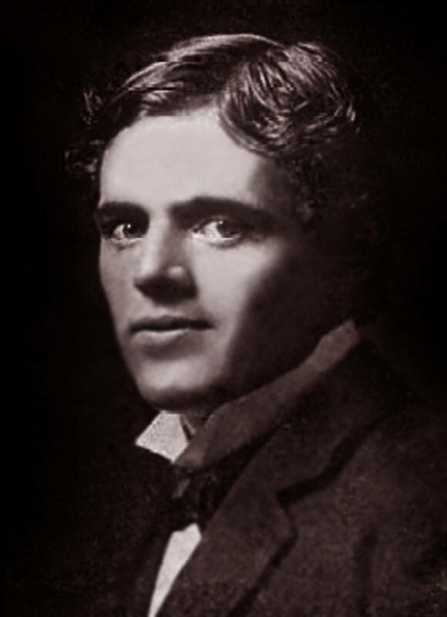
«From Cradle to Fame: The Beginning of Jack London’s Journey»
London’s writing career began while he was still working. His first significant success came in 1899 with the publication of «To the Man on the Trail». What followed was an astonishing rise to fame. London quickly became one of the first authors to earn a million-dollar fortune from his writing, setting a new standard for literary success.

Slide 5
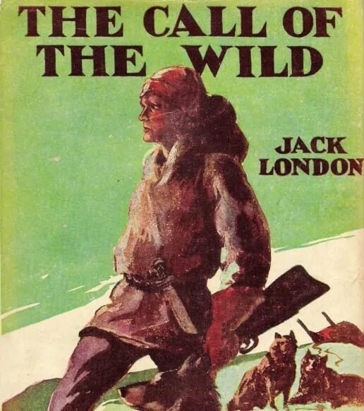
«San Francisco’s Gift to Literature: The Birth of a Literary Giant»
London’s literary legacy includes numerous classic works that continue to captivate readers around the world. Among his most famous novels are “The Call of the Wind”, “White Fang” and “The Sea Wolf”. His autobiographical novel “Martin Eden” and the dystopian “The Iron Heel” are also highly regarded.

Slide 6
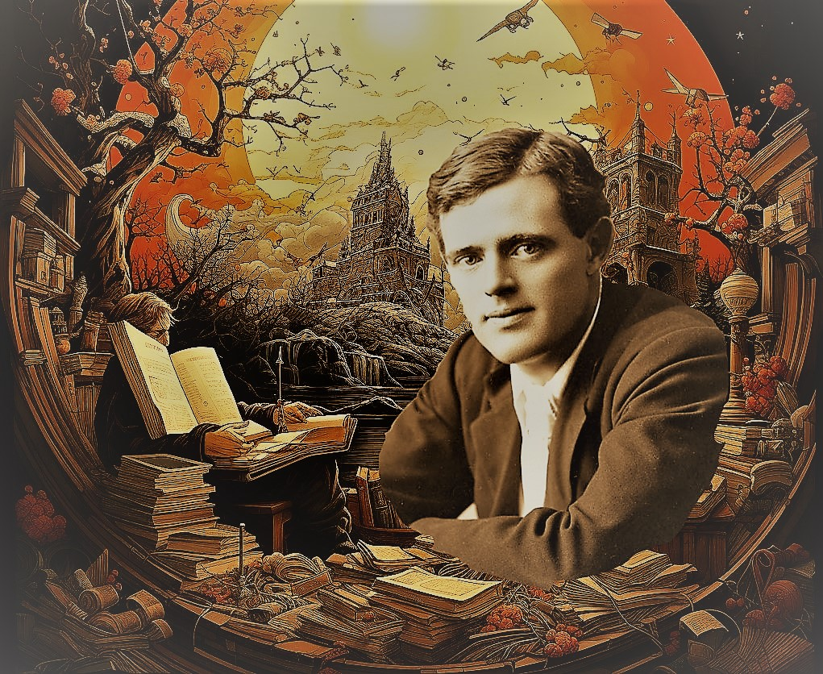
«The American Dream Takes Shape: Jack London’s Early Years»
London’s writing was characterized by several key themes: survival against nature, social justice, the human spirit and adventure. His works were known for their action-packed plots, vivid descriptions and realistic characters. He had a unique ability to combine thrilling adventure stories with deep social commentary.

Slide 7
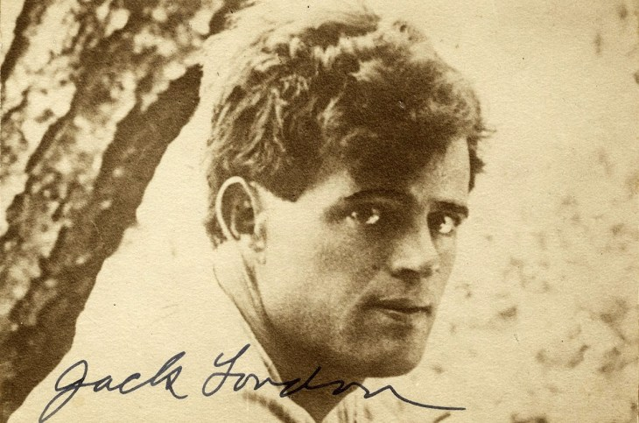
«From Humble Beginning to Literary Greatness: The Birth of Jack London»
The influence of Jack London’s work extends far beyond his lifetime. With over 500 million copies sold worldwide, his books have been translated into numerous languages and continue to inspire readers globally. As a modern literary critic notes, “London’s works continue to inspire readers with their timeless themes of courage and survival”.

Slide 8

«The Man Who Lived His Stories: The Epic Tale of Jack London»
Jack London died on November 22, 1916, at the age of 40, but his legacy lives on. As a contemporary writer observed, “He showed the world that literature could be both entertaining and thought-provoking”. Indeed, London remains a symbol of the American dream - a man who rose from poverty to become one of the world’s most celebrated authors.

Slide 9
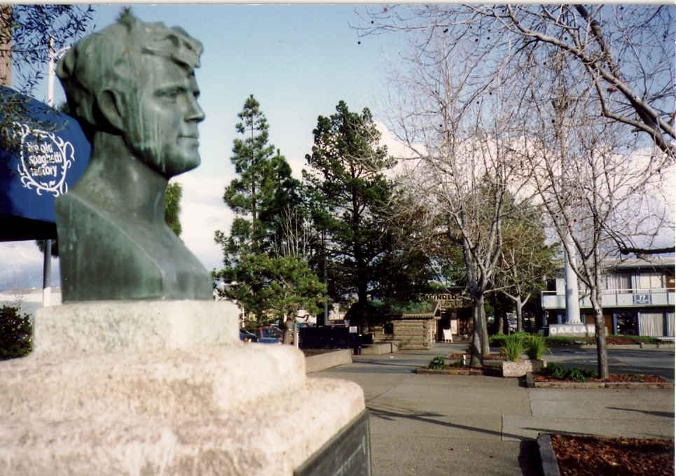
«Jack London: When Reality Becomes Legend»
As a biographer aptly put it, “Jack London remains a symbol of the American dream – from rags to literary riches”. His disciplined work ethic, socialist beliefs and extensive travels around the world all contributed to making him one of the most influential writers of his time, whose works continue to be read and admired today.

Slide 10
Questions for Discussion
Why are London’s works still popular today?
What character traits do London’s heroes share?
How did the writer’s personal life reflect in his works?
Which London work would you recommend reading first?
What is the secret of London’s works’ success?
How did London’s life experiences influence his writing?

Slide 11
Questions for Discussion
How did London’s life experiences influence his writing?
What social issues did London address in his works?
Why do readers find London’s characters relatable?
How did London’s travels impact his writing?
What makes London’s adventure stories unique compared to other authors?

Slide 12
«In His Own Words: Quotes by Jack London»
«Life is what people strive to preserve most and respect least»;
«Labor is not a curse, but a blessing»;
«A man is what he believes».
«Жизнь – это то, что люди больше всего стремятся сохранить и меньше всего берегут»;
«Труд – это не проклятие, а благословение»;
«Человек – это то, во что он верит».

Slide 13
Quiz: Test Your Knowledge About Jack London
1. Where did Jack London spend his childhood?
In a wealthy family in downtown San Francisco;
In a poor family on the outskirts of the city;
On a farm in the countryside.
2. What unusual job did young Jack London?
Worked in a library;
Hunted seals;
Sold newspapers.
3. What inspired London to start writing?
Teacherʹs advice;
Desire to get rich;
His own life experience.
4. Which work made London famous?
“The Call of the Wild”;
“The White Fang”;
“The daughter of the Snows”.
5. What theme unites most of Londonʹs works?
Manʹs struggle with nature;
Love and romance;
Political intrigue.

Slide 14
Quiz: Test Your Knowledge About Jack London
6. In which work did the author describe his path to success?
“The Sea Wolf”;
“Martin Eden”;
“The Iron Heel”.
7. How many books did Jack London write in his lifetime?
More than 50;
About 100;
More than 200.
8. Why did London stop writing?
Because of illness;
Lost interest in literature;
Went traveling.
9. Which of Londonʹs characters is considered the most popular?
White Fang;
Buck (from “The Call of the Wind”);
Martin Eden.
10. What influence did London have on literature?
Became the founder of the adventure genre;
Changed the perception of social prose
Both options are correct.

Slide 15
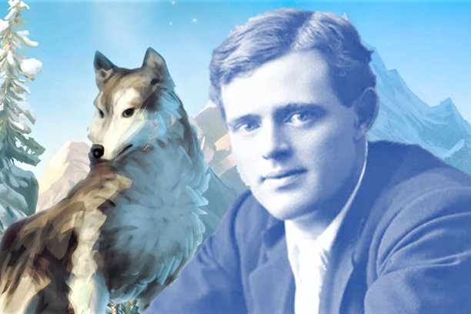
«London wrote what he lived, and lived what he wrote».

