Slide 1
Step 12
November, 30th

Slide 2
Повторим алфавит. Какие буквы мы уже изучили?
Let’s revise all together!

Slide 3
Прочитай слова.

Slide 5
Why?
a
an
cat
dog
troll
sheep
dad
lorry
frog
fox
tent
bell
nest
elf
apple
orange
egg
elephant
umbrella
apricot

Slide 6
a or an
cat
elf
dog apple
troll
sheep
elephant
dad
umbrella
frog
apricot
fox
orange
egg
tent
bell
nest

Slide 7
I can see … sheep.
Harry is … troll.
You can see … big lorry.
I can see … cat and … dog.
Emily is … elf.
I can see … fox and … frog.
It is … pen.
a
a
a
a
a
an
a
a
a

Slide 8
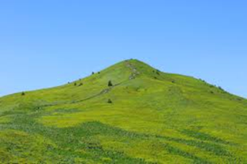
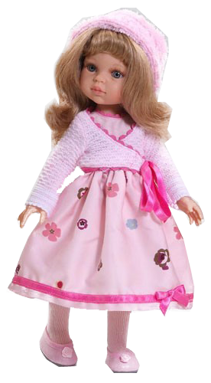
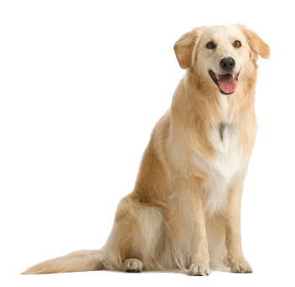
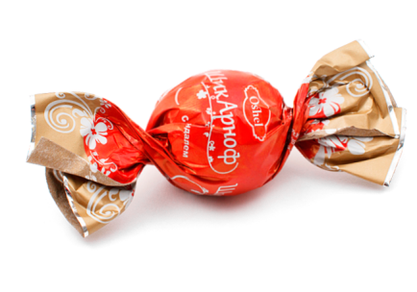
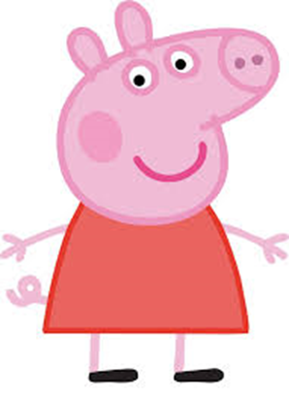
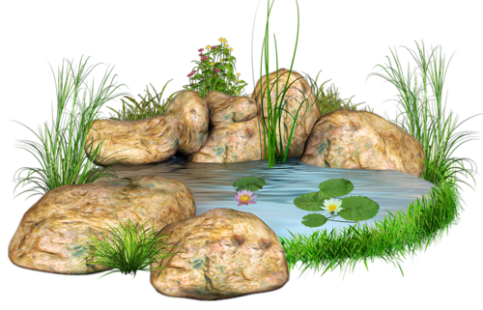
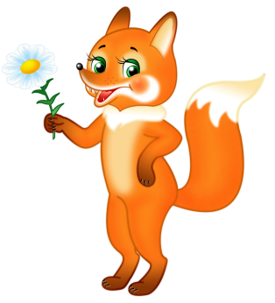
Назови, что ты видишь.
I can see a …
I can see an …

Slide 9
Let’s play with words!
Try to make up a sentence in pairs!

Slide 11
No, it isn’t. It is a…

Slide 12
Listen, read and say!
ex.5 p. 39

Slide 13
Homework

