Slide 1
Olimpic games
Голубова Яна ЛЭ9-20

Slide 2
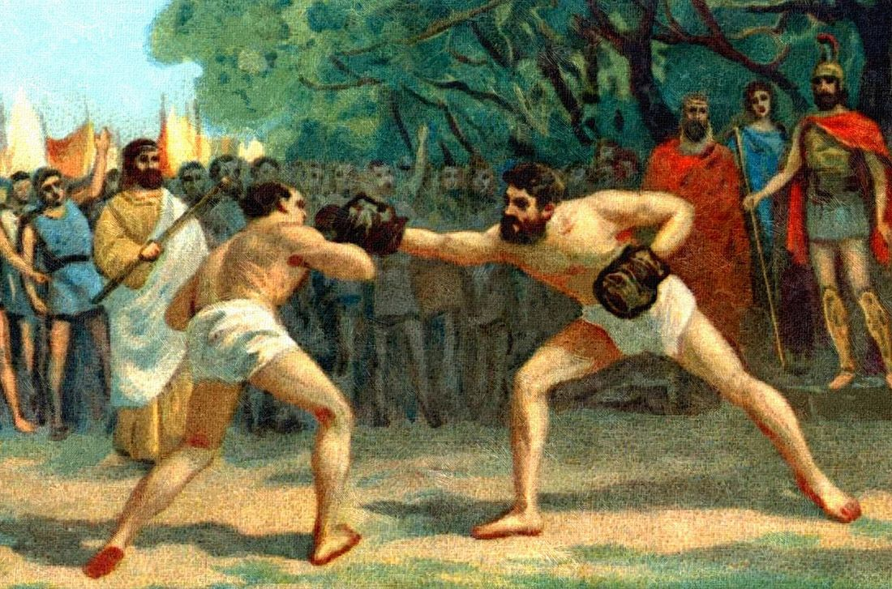
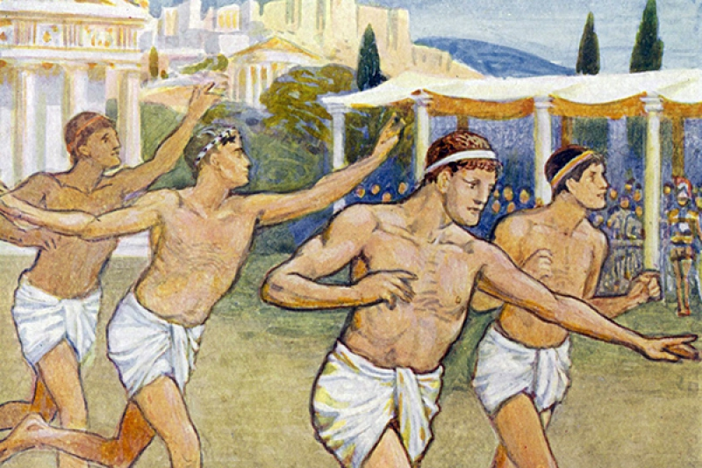
The Olimpic Games have a very long history. They began in 777 B.S. in Greece and took place every four years for nearly twelve centuies at Olimpia. They included many different kinds of sports: running, boxing, wrestling, et cetera. All the city-states of Greece sent their best athlets to Olimpia to compete in the Games. For the periods of the Games all the wars stopped, thus the Olimpic Games became the symbol of peace and friendship.

Slide 3
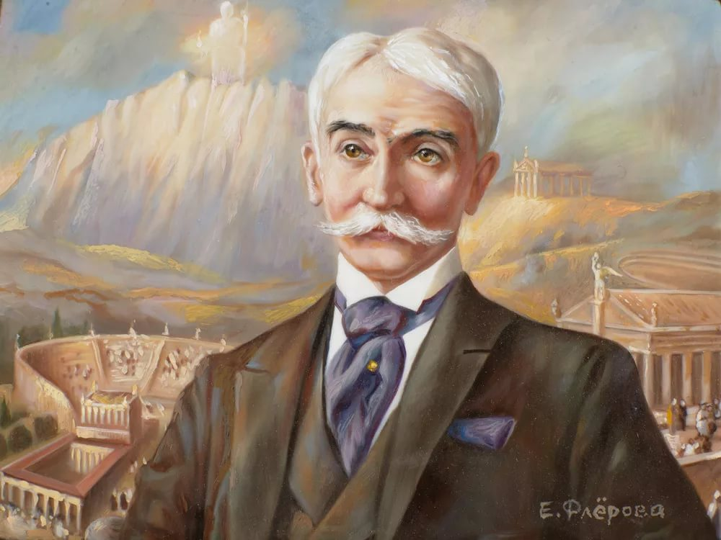
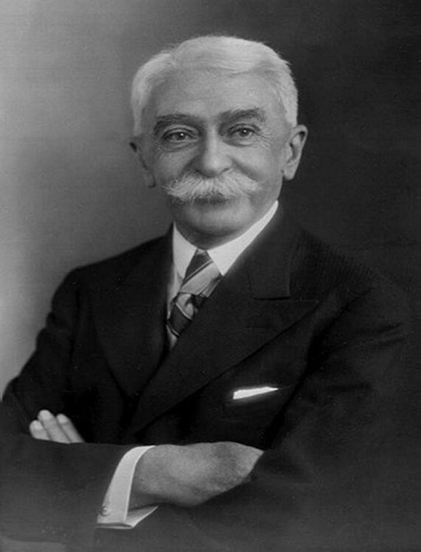
In 394 A.D. the Games stopped and were not renewed until many centuries later.
In 1894 a frenchman, Baron Pierre de Coubertin addressed all the sports governing bodies and pointed out the significance of sports and its educational importance for modern nations

Slide 4
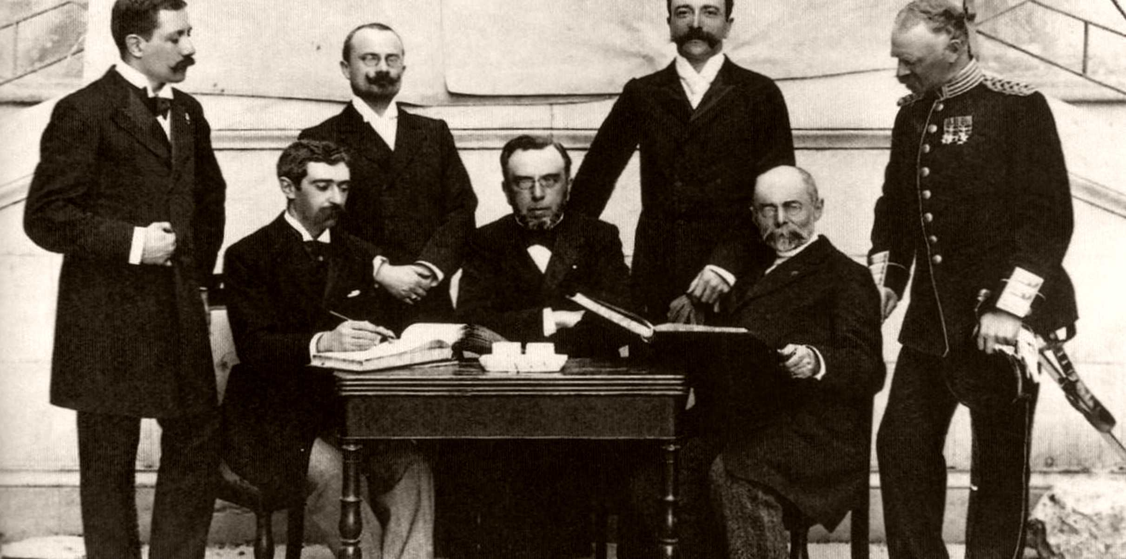
Two years later the first modern Games took place. Of cource, the competitions were held in Greece to symbolize the continuation of the centuries-old tradion. In 1896 the central policy-making body on the Olimpic Movement, the International Olimpic Committee was set up.

Slide 5
It is up to now formed by the representatives of all countries, which participate in the Olimpic Games. The International Olimpic Commit tee decides upon the programme of the games, the number of the participants, the city-host for the Games. Over one hundred and fifty countries are represented in the International Olimpic Contfilltee now. Besides, each country has its National Olympic Committee, which has to select the athletes for the Games and to provide them with all necessities, to organize their training.

Slide 6
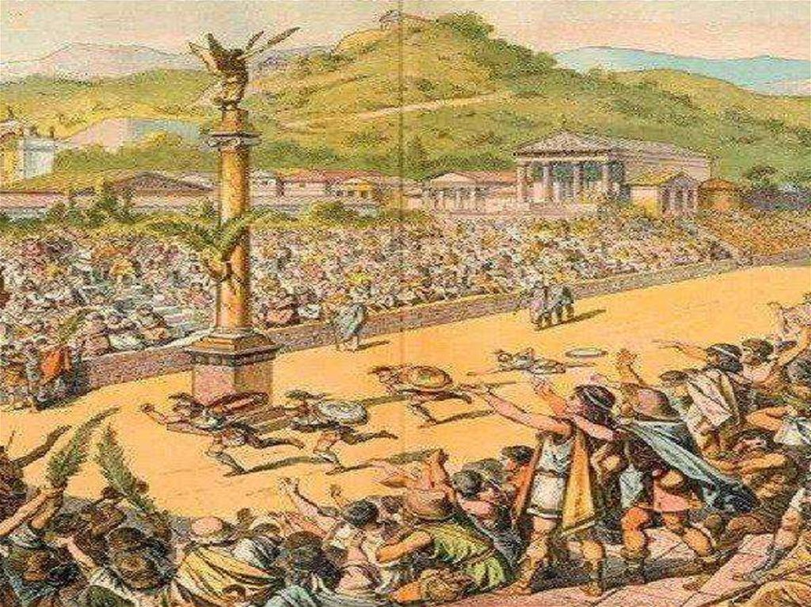
Summer and Winter Games are held separately. There are always several cities which wish to host the Games. The most suitable is collected by the International Committee. After that the city of the Games starts preparations for the competitions, constructs new sports facilities, stadiums, hotels, press centres. Thousands of athlets, journalists and guests come to the Games, and it takes great efforts to arrange everything. There is always an interesting cultural programme of concerts, exhibitions, festivals, etc., for each Games.

Slide 7
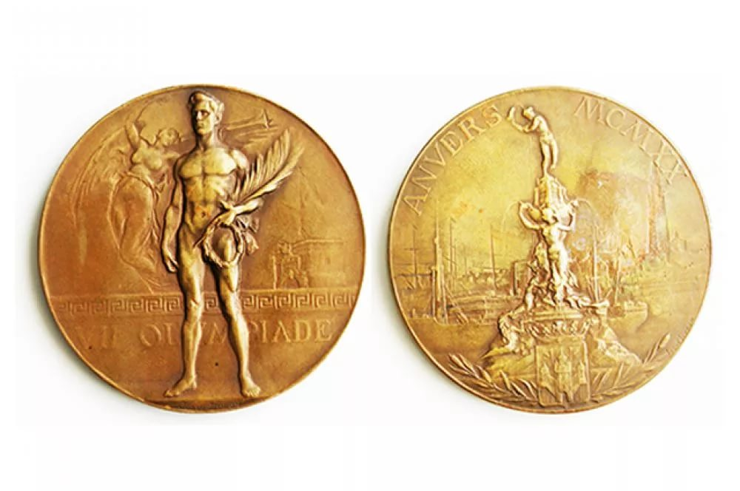
Russia joined their Olympic Movement in 1952. It always wins many gold, silver, and bronze medals in the competitions since then. In 1980 Moscow hosted the Twenty Second Olympic Games.

Slide 8
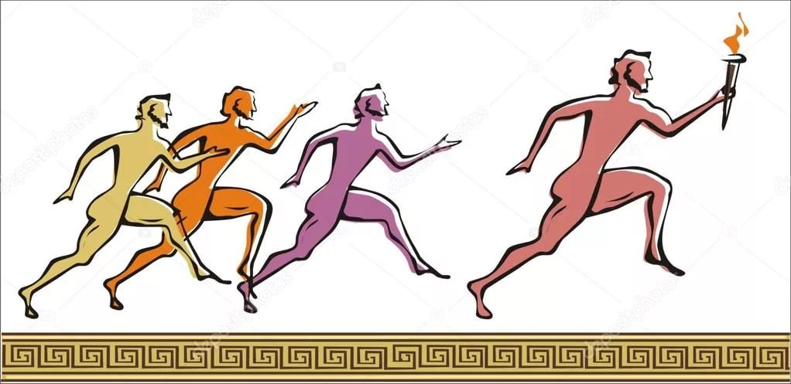
For the opening of the Games, the fire, lit in Greece from the sun, is brought by runners, who pass through territories of many countries on their way. All the national teams parade at the opening ceremony, the anthem of the Olympic Movement is performed. After that the festival of health, friendship, and peace starts.

