Slide 1
My favourite book
Материал подготовил
Учитель иностранного языка
Затолгутская Елена Анатольевна

Slide 2
Read Hanna’s opinion about reading:
I am completely keen on reading. I try to read every day. I like fantasy stories and some adventurous stories. And there is a story of that kind I am eager to read over and over again. Its name is “Harry Potter.” The story was written by a popular British writer J. K. Rowling. And it tells us about a little boy Harry who lives in a family of his aunt. One day he finds out that he is a wizard and should go to study to a school of magic — Hogwarts. And that’s where the story begins. In the following 7 parts we get to know what a great wizard Harry is. He meets new friends, studies, does sport and conquer the most evil magician in the world. I love this book for all of this. I have already read it a few times. And I know that I will definitely read it once again.

Slide 3

Let’s talk about books. start
I am completely keen on reading. I try to read every day.
Начните рассказ: примеры
I like to read books.
I love reading.
I am fond of reading.
и т.д.

Slide 4

Genre
I like fantasy stories and some adventurous stories. And there is a story of that kind I am eager to read over and over again.
напишите какой жанр книг вам нравится:
What is your favourite genre?
action
mystery
detective
science fiction
fairy-tiles
history
novel
fantasy

Slide 5
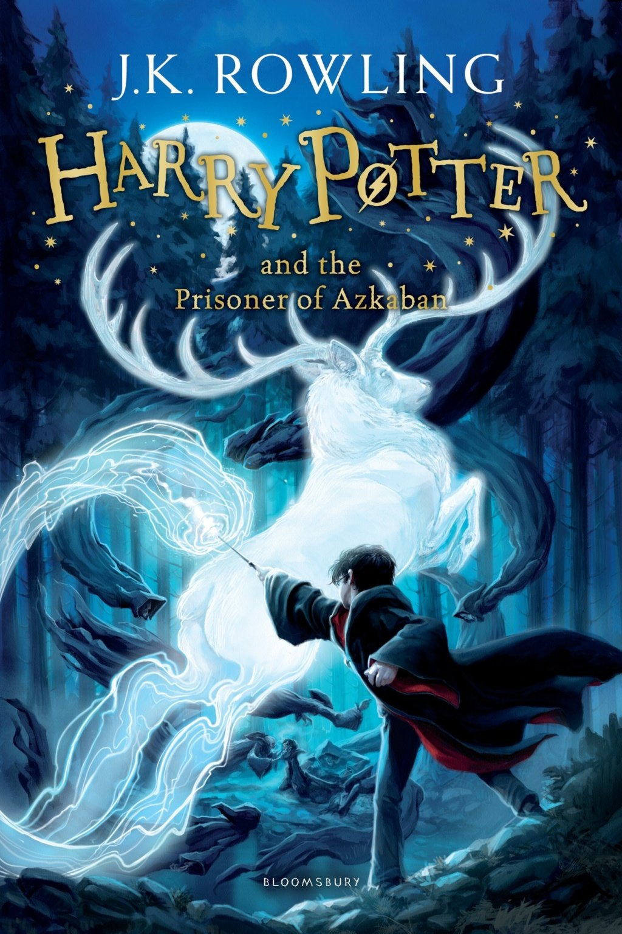
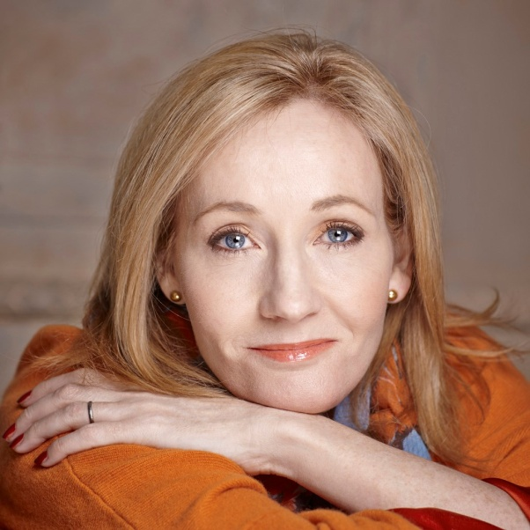
Book name and author
Its name is “Harry Potter.” The story was written by a popular British writer J. K. Rowling.
напишите название книги и автора:

Slide 6
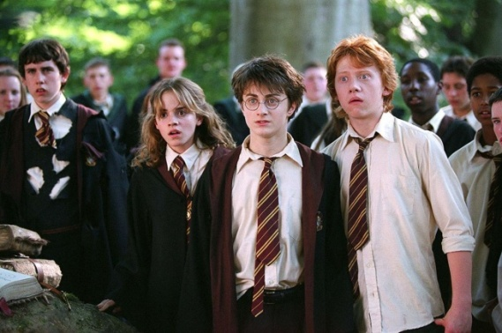
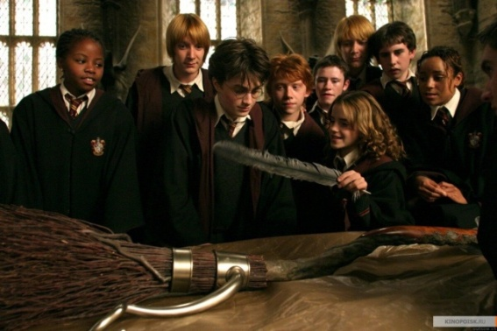
Plot of the book
And it tells us about a little boy Harry who lives in a family of his aunt. One day he finds out that he is a wizard and should go to study to a school of magic — Hogwarts. And that’s where the story begins. In the following 7 parts we get to know what a great wizard Harry is. He meets new friends, studies, does sport and conquer the most evil magician in the world.
расскажите (кратко) сюжет книги:

Slide 7

Finish
I love this book for all of this. I have already read it a few times. And I know that I will definitely read it once again.
вывод - заключение

Slide 8
Составьте текст по теме “ My favourite book ” по плану:
Introduction
Your favourite genres of book
Your favourite book
The plot of your favourite book
The author of your favourite book
Conclusion

