Slide 1
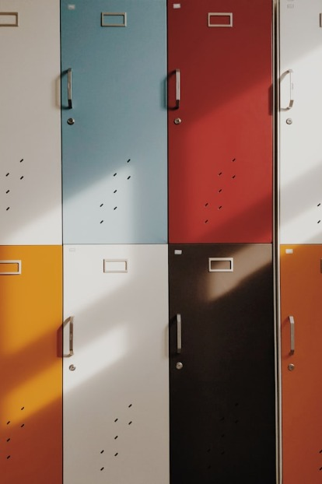
Education systems in Russia and Spain
comparison of these systems

Slide 2
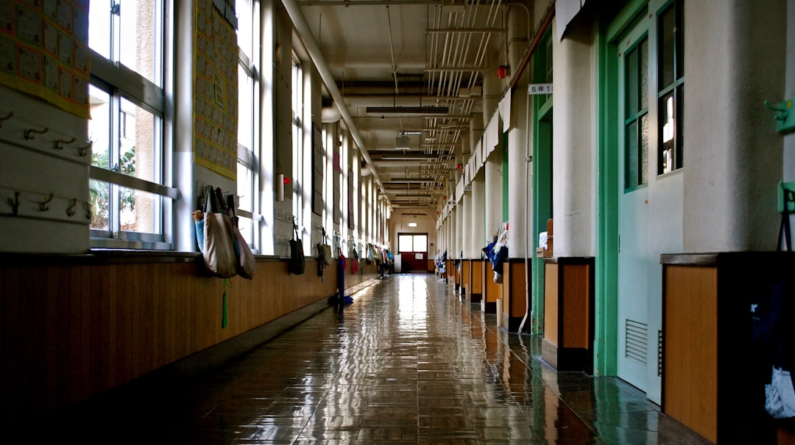
Introduction:
Russian system
Spanish system
Similarities
Differences

Slide 3

Дошкольное образование pre-school education
( ages 3 – 7 )
Начальное общее образование primary general education
( ages 8 – 12 )
Основное общее образование basic general education
( ages 13 – 16 )
Среднее общее образование general secondary education
( ages 17 – 18 )
Russian system

Slide 4
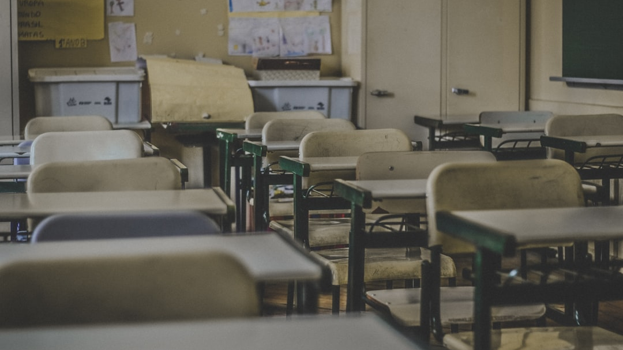
LA EDUCACI Ó N INFANTIL pre-school education
( ages 3 - 6 )
LA EDUCACIÓN PRIMARIA primary general education
( ages 7 - 12 )
LA EDUCACIÓN SECUNDARIA OBLIGATORI A basic general education
( ages 13 – 16 )
EL BACHILLERATO bachelor course
( ages 17 – 18 )
Spanish system

Slide 5

Similarities:
Stages of education.
Forms of education.
Compulsory education.
The first stages of education are free of charge.
The age of completion of the stages of education.

Slide 6

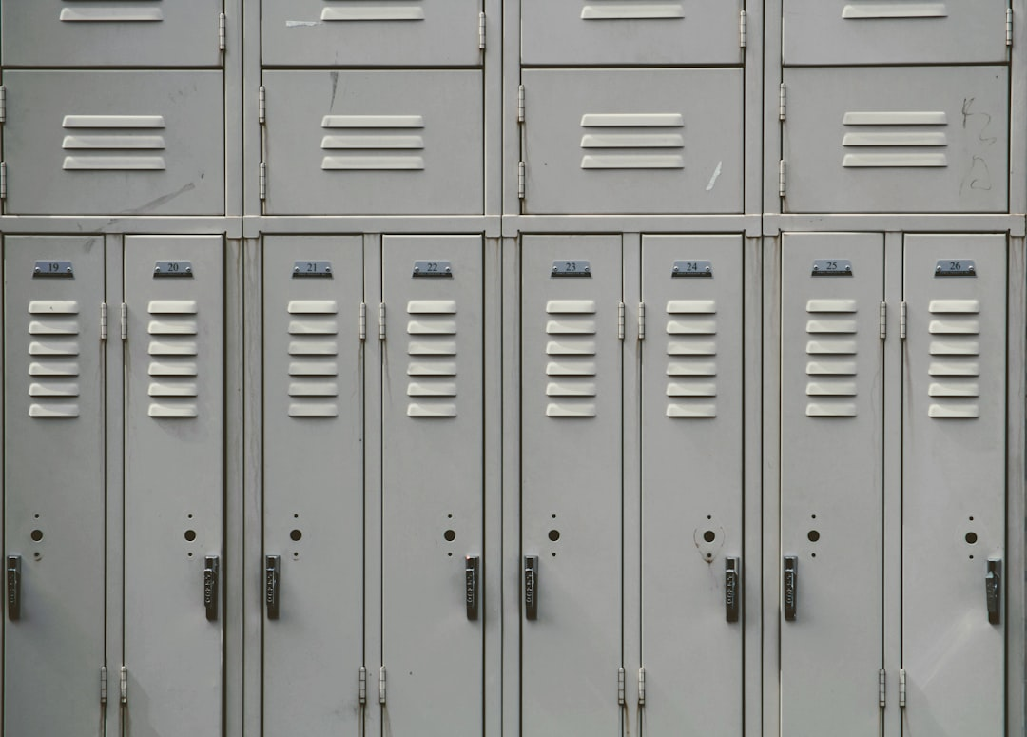
Differences:
Pre-school education.
Post-secondary education.
Academic year.

Slide 7


Thank you so much for your attention!
Спасибо огромное за внимание!
For you

