Slide 1
Блиц-игра «Лексика»
Лыкова Екатерина Евгеньевна, ИЯИЯа-17-1

Slide 2
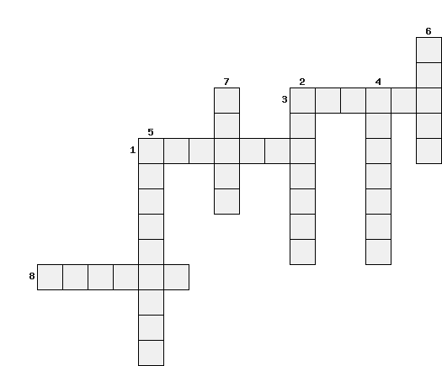
Do this crossword puzzle. The topic of it is «Professions».
n
u
a
d
o
c
t
o
r
c
e
e
s
P
o
s
t
m
a
n
a
e
o
o
t
c
l
r
i
h
i
s
e
c
t
r
w
a
i
t
e
r
m
a
n

Slide 3
Questions:
This person brings you letters.
This person treats your teeth.
This person works in a hospital.
This person teaches you at school.
This person catches criminals.
This person takes care of your baby when you are working.
This person acts in films.
This person brings your food at the restaurant.

